Slide 1

WoRKplace surveillance under covid-19
Hasan Arda Erbil
What are the rules on workplace surveillance? - BBC News
Notes:
First of all, I would like to start by introducing myself and welcoming everyone. My name is Arda Erbil and I’m a student in Centennial College. Today I will be talking about how anti-COVID19 prevention technologies and monitoring solutions has changed workplaces, along with their employees and employers. Not to forget, I will talk about possible actions that could reduce this effect(s).

Slide 2
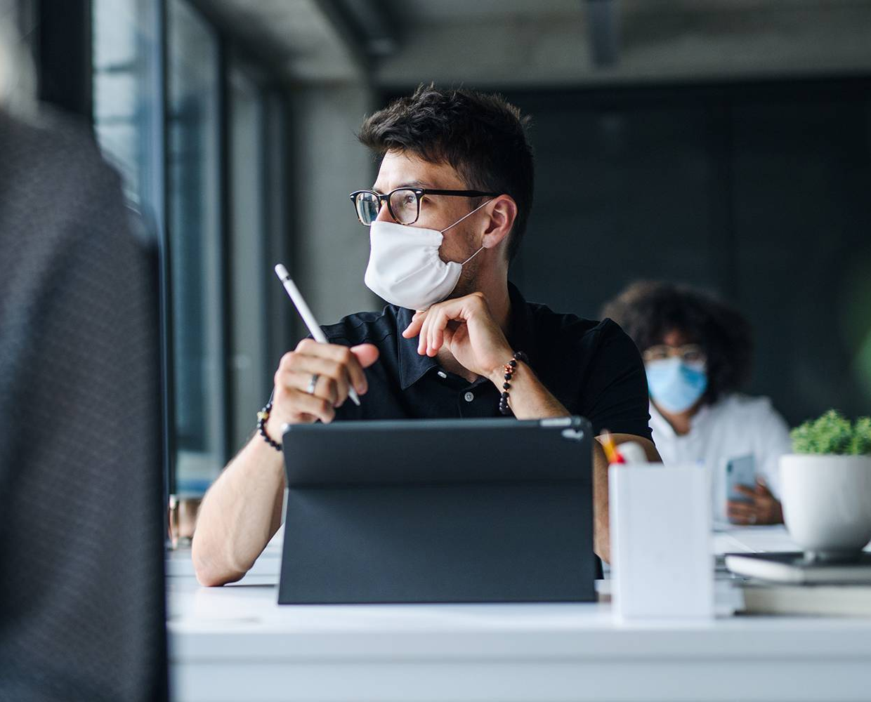
Covıd-19 Impact
How did it affect workplaces?
Notes:
As we all know, the COVID-19 pandemic has changed our lives drastically. Naturally, workplaces took and our daily routines took a big hit. Imagine waking up to only see that people at your work wearing masks, and keeping their distance from the others. As you can tell, this already shows how the dynamics of a workplace has changed, even though we have gotten used to it progressively.

Slide 3
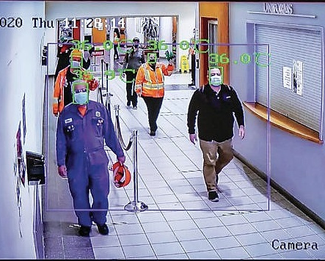
New solutions
The evolution of pandemic prevention technologies
The workplace of the future will probably remain under surveillance - Macleans.ca
Notes:
But these measures weren’t enough. Step by step, new prevention technologies and monitoring solutions were introduced to the workplaces. Surveillance cameras with face recognition capabilities, network scanning technologies that can read your private messages. The list goes on. You may ask: “Some of these aren’t even related with pandemic prevention solutions. Why are these technologies are being used?”.

Slide 4

Usage of Workplace Surveillance
Was it a thing before COVID-19?
Pressure to return to the office could be making employees more anxious (phys.org)
Notes:
Pandemic was one of the main reasons why monitoring technologies were introduced however, that doesn’t mean that they weren’t being used in the industry. For example, these technologies are common in finance sector, as companies are legally required counteract any potential insider trading. But it is safe to say that pandemic has significantly accelerated the implementation of this process.

Slide 5

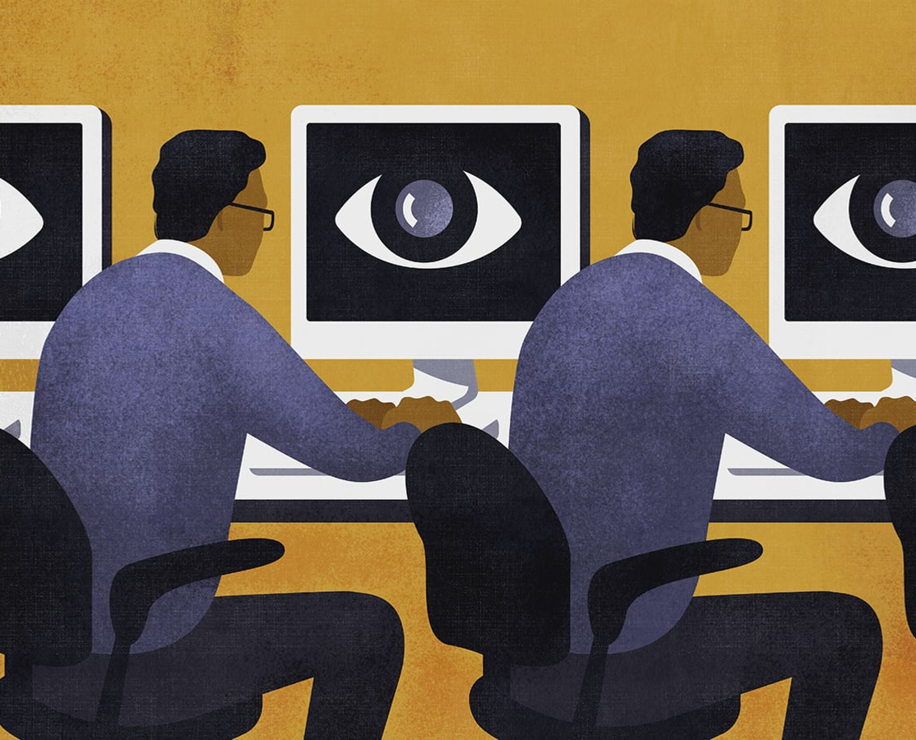
THE CONVENIENCE
How effective are these technologies?
7 Workplace Monitoring Laws Of Different Countries: Legal Restrictions & Best Practices - Empmonitor Blog
Notes:
As companies adapted these technologies, employers realized how convenient these solutions were. Afterall, these monitoring technologies are for improving employee productivity, right? They could monitor number of mails sent, documents that has been processed and amount of time spent.

Slide 6
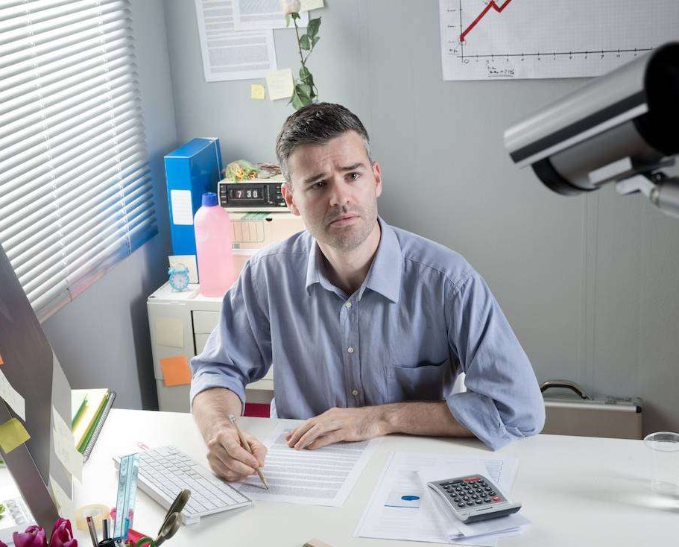
THE ABUSE
Are employers taking it too far?
Laws and Ethics of Employee Monitoring and Privacy - businessnewsdaily.com
Notes:
Companies started abusing these technologies and things took a big turn. Within time, employers were able to view employees’ private messages. Screenshots from their devices and the context of %95 of what they do with the help of AI. A government agency has even requested a face tracking software, but the technology provider denied as it was the “red-line”.

Slide 7


Unexpected turn of events
Why did these solutions backfire?
5 Strategies to Address Employee Stress in the Workplace (corporatewellnessmagazine.com)
Notes:
7 Eventually, this maltreated monitoring concept backfired. The ideology that was supposed to increase efficiency has decreased workplace productivity. Some employee morale’s were so much hurt that they lost their motivation.

Slide 8

FUTURE OF THE WORKPLACE SURVEILLANCE
Monitoring solutions are here to stay.
Surveillance at Work: How Far Is Too Far? (lawyer-monthly.com)
Notes:
8 Now, the punchline. We can’t change the fact that these technologies are deep inside the industry at this point. At this rate, these technologies will become a part of the future workplaces. As much as employees’ are affected by this, these tools still come in handy to the employers.

Slide 9

RE-CONSTRUCTION OF THE MONITORING CONCEPT
The voice of the employees is the key.
Notes:
If these surveillance systems are still so controversial, how companies are going to establish a healthy work environment? It is obvious that things aren’t going to change in a snap of a finger. This is the part where employees stand up for their rights.

Slide 10

NEW STANDARTS
Humane and privacy-respecting solutions
10 Reasons Why It Is Important Create a Happy Workplace | Inc.com
Notes:
10) To prevent privacy abuse in the future, industry needs universal monitoring standards. Standards that companies can’t alter and employee privacies that can’t be abused. Most importantly, employees should have the right to express themselves and make propositions whilst these standards are being set.

Slide 11

THANK YOU
Trabajo Colaborativo | 7 claves para aprovechar sus beneficios (bizneo.com)
Notes:
How about you, what are your experiences in a monitored workplace?
Thank you.

